Slide 1

Machine Learning Prediction
Otniel Abiezer

Slide 2
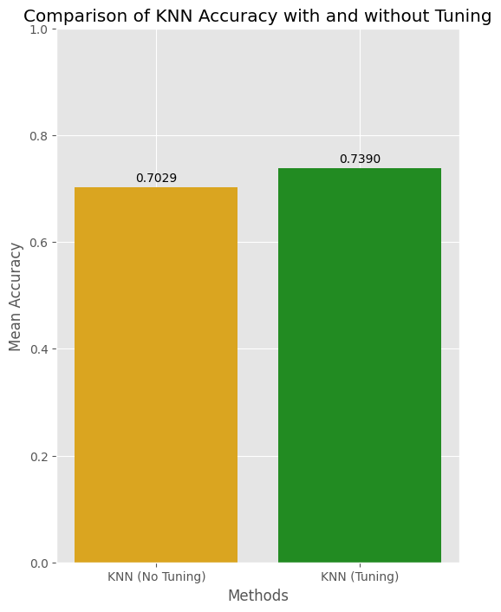
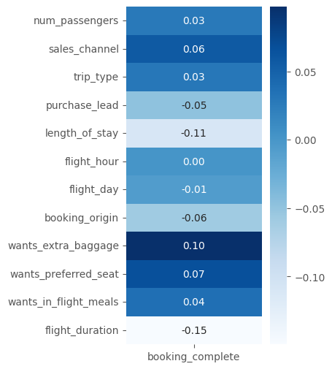
Top 3 variables that effect booking_complete:
flight_duration, length_of_stay, wants_extra_baggage
Dataset Type | Q | PR | RC | F1
Train | 0.97 | 0.99 | 0.95 | 0.97
Test | 0.74 | 0.77 | 0.68 | 0.72
Prediction | 1 | 28522 | 126
 | 0 | 1243 | 29639
Confusion Matrix Data Train |  | 1 | 0
 |  | Actual
Prediction | 1 | 8794 | 2598
 | 0 | 3963 | 10159
Confusion Matrix Data Test |  | 1 | 0
 |  | Actual
The customer who completes the book tend to want short flight and stay

